Slide 1
Assessment of the demand for parking in Helsinki using multimodal accessibility measures
Research plan
MSc thesis, geoinformatics
Julius Krötzl

Slide 2
Contents
Introduction
Scientific motivation
Study questions
Methods
Data sources
Expected results
Schedule of the thesis
Bibliography

Slide 3
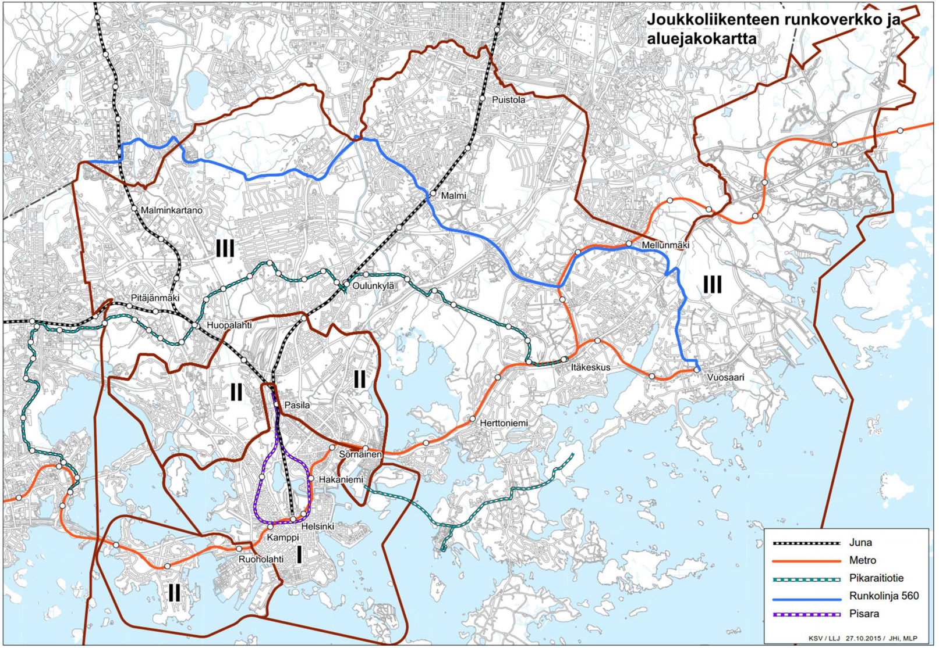
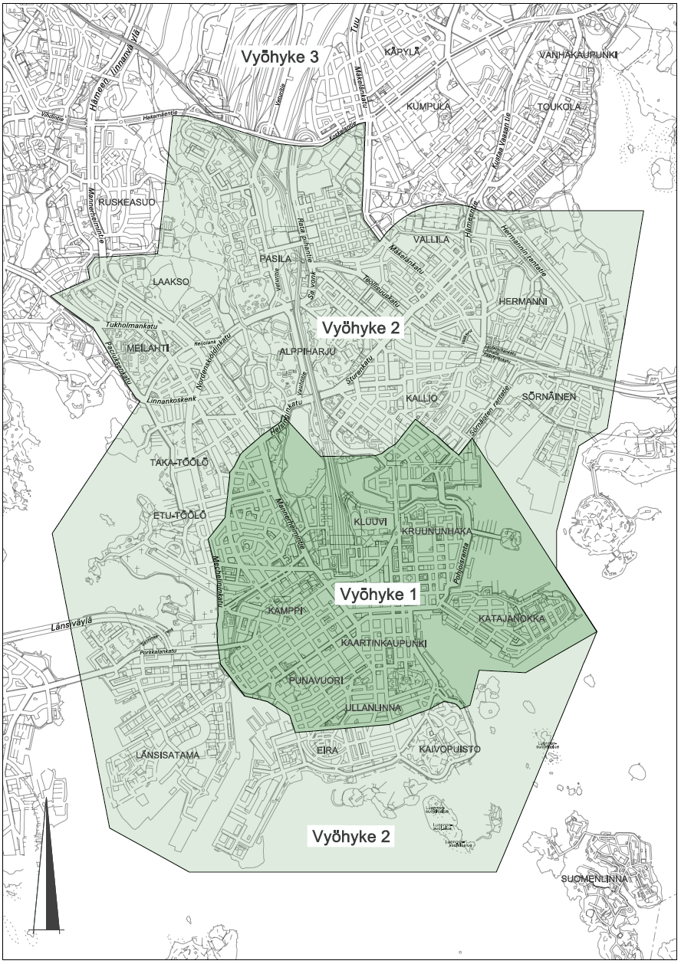
1. Introduction
Helsinki’s objective is to move towards an areal and market-based parking system in order to densify urban structure and to restrain the growth in housing prices
The aim of this thesis is to use accessibility measures:
for identifying the areas where a good public transportation system and good walking and cycling accessibility allows the planning of less parking spaces in new housing areas and
for assessing the pressure on parking spaces (parking fee areas)
This thesis also aims to model cycling accessibility in order to identify the areas where bicycle parking is most urgently needed
Areal division of the parking place standard
Parking fee areas
Notes:
Area I: 1 pp/ 150 m2
Area II: 1 pp / 135 m2
Area III: 1 pp / 100 m2

Slide 4
1. Introduction
Current parking place standard for new housing (Helsingin kaupunki 2015)
Area I: 1 pp/150 m2 gross floor area
Area II:
1 pp / 135 m2
If distance to the next rail station (metro/train) is less than 400m → 1 pp / 145 m2
Area III: 1 pp / 100 m2
Distance to a rail station less than 300 m → 1 pp/ 140 m2
Distance to a rail station 300-600 m or to a light rail stop less than 600 m → 1 pp/ 130 m2
Distance to a rail station 600-900 m → 1 pp/ 110 m2
Distance to a stop of the bus line 560 less than 600 m → 1 pp/ 120 m2
Areal division of the parking place standard
Bicycle parking:
all areas: 1 pp / 30 m2 gross floor area
Notes:
Area I: 1 pp/ 150 m2
Area II: 1 pp / 135 m2
Area III: 1 pp / 100 m2

Slide 5
2. Scientific motivation
The work will be done as a Master’s thesis assignment for the division of transport systems at the City of Helsinki and the accessibility results can be applied also to other projects at the City of Helsinki
Until now, the areal division of the parking place standard consists of three areas. Besides that, the straight-line distance to the next metro/train/light rail stop also affects the parking place standard.
The aim of this thesis is to create a more accurate division using accessibility areas
Study hypothesis: those areas that are well-connected to the public transportation system have less demand for parking

Slide 6
3. Study questions
What are the key parameters affecting the parking place standard?
How is the correlation between public transportation accessibility and car ownership?
What are the main differences between the MetropAccess Travel Time Matrix and the HRT HELMET-model?
What type of accessibility measure is most suitable for assessing the parking place standard?

Slide 7
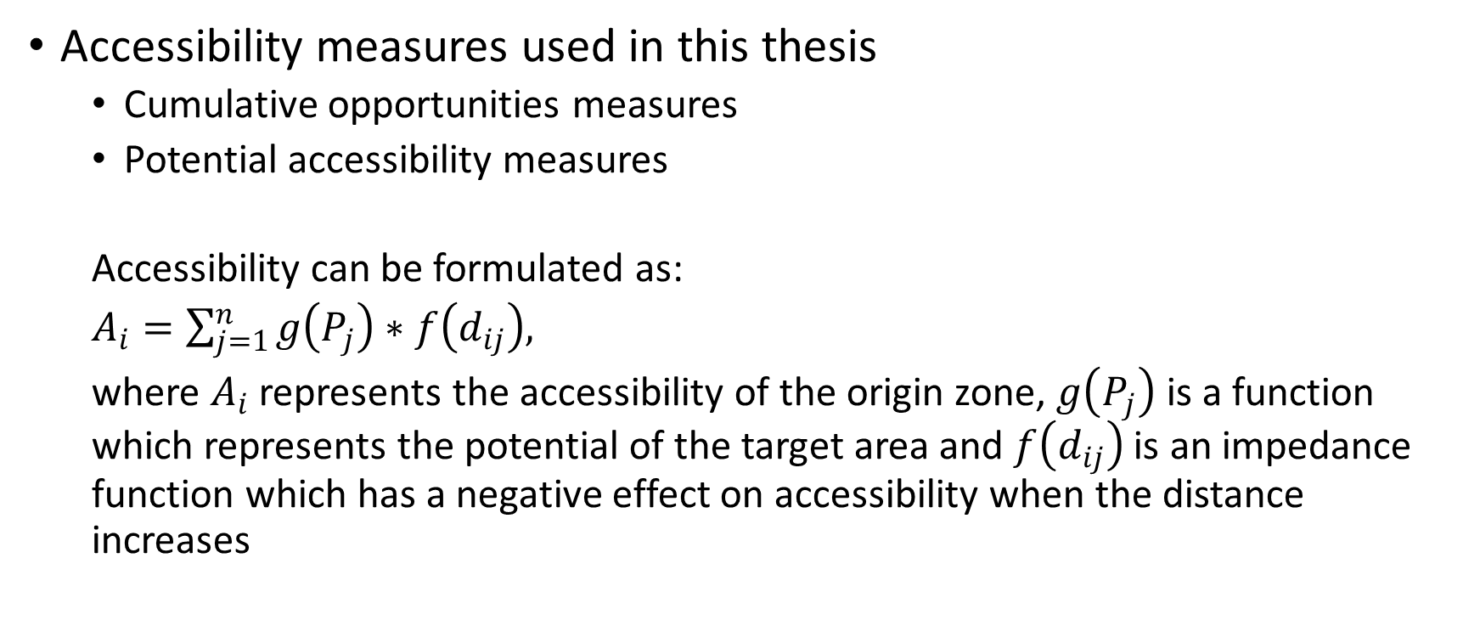
4. Methods (1/8)
Accessibility measures used in this thesis
Cumulative opportunities measures
Potential accessibility measures
Accessibility can be formulated as:
$A_{i}=\sum_{j=1}^{n}{g\left(P_{j}\right)∗f\left(d_{ij}\right),}$
where $A_{i}$ represents the accessibility of the origin zone, $g\left(P_{j}\right)$ is a function which represents the potential of the target area and $f\left(d_{ij}\right)$ is an impedance function which has a negative effect on accessibility when the distance increases

Slide 8
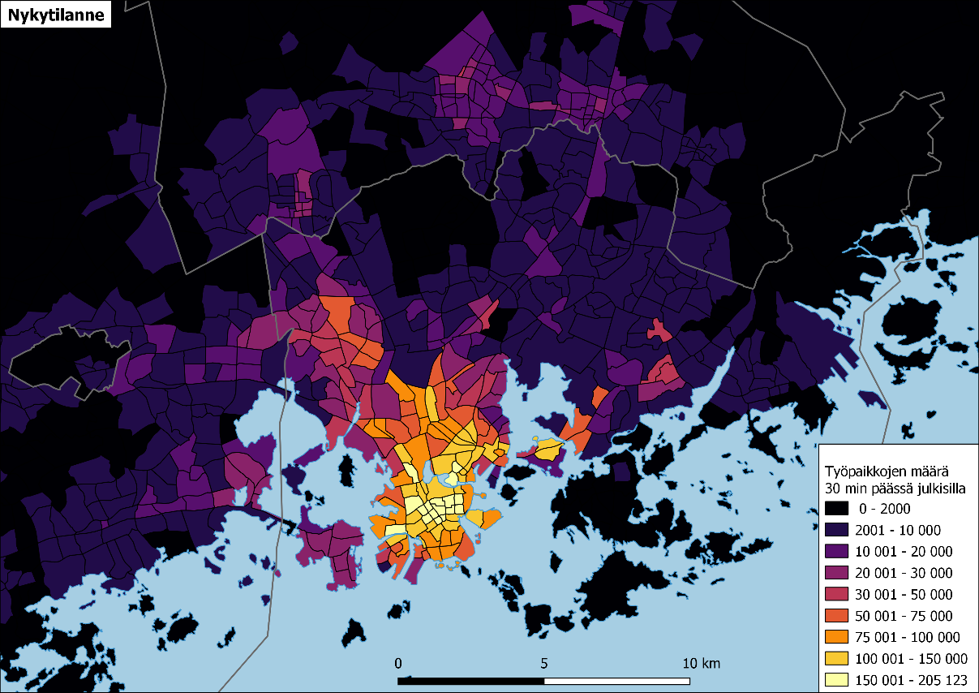
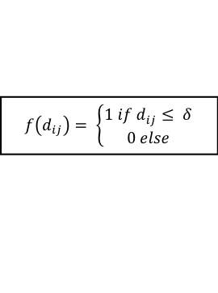
4. Methods (2/8)
$$f\left(d_{ij}\right)= \left\{\begin{aligned}1 if d_{ij}≤ δ \\ 0 else\end{aligned}\right.$$
Cumulative opportunities measures
How many opportunities can be reached within a given travel time limit
Advantages:
Easy to intepret
Connects the land-use and transportation components of accessibility
Disadvantages:
It assumes that all objects are equally desirable
Arbitrary selection of the isochrone

Slide 9
4. Methods (3/8)
Potential accessibility measures
Are based on Tobler’s I law of geography: ”everything is related to everything else, but near things are more related than distant things” (Tobler 1970)
Different impedance functions have been researched to model the friction of travel time (Kwan 1998)
Inverse power function
Negative exponential function
Modified Gaussian function

Slide 10
4. Methods (4/8)
Inverse power function
Advantages:
Accessibility declines at larger distances
Function approaches but never reaches zero
Disadvantages
Accessibility in the origin zone (distance=0) cannot be incorporated, because division by zero is undefined
Accessibility falls too rapidly in short distances

Slide 11
4. Methods (5/8)
Negative exponential function
According to Geurs & van Wee (2004) the most used impedance function
Advantages:
Accessibility doesn’t decline as rapidly as with the inverse power function
Does not have the problem of division with zero
Disadvantages
Emphasises the accessibility of nearby opportunities still too much

Slide 12
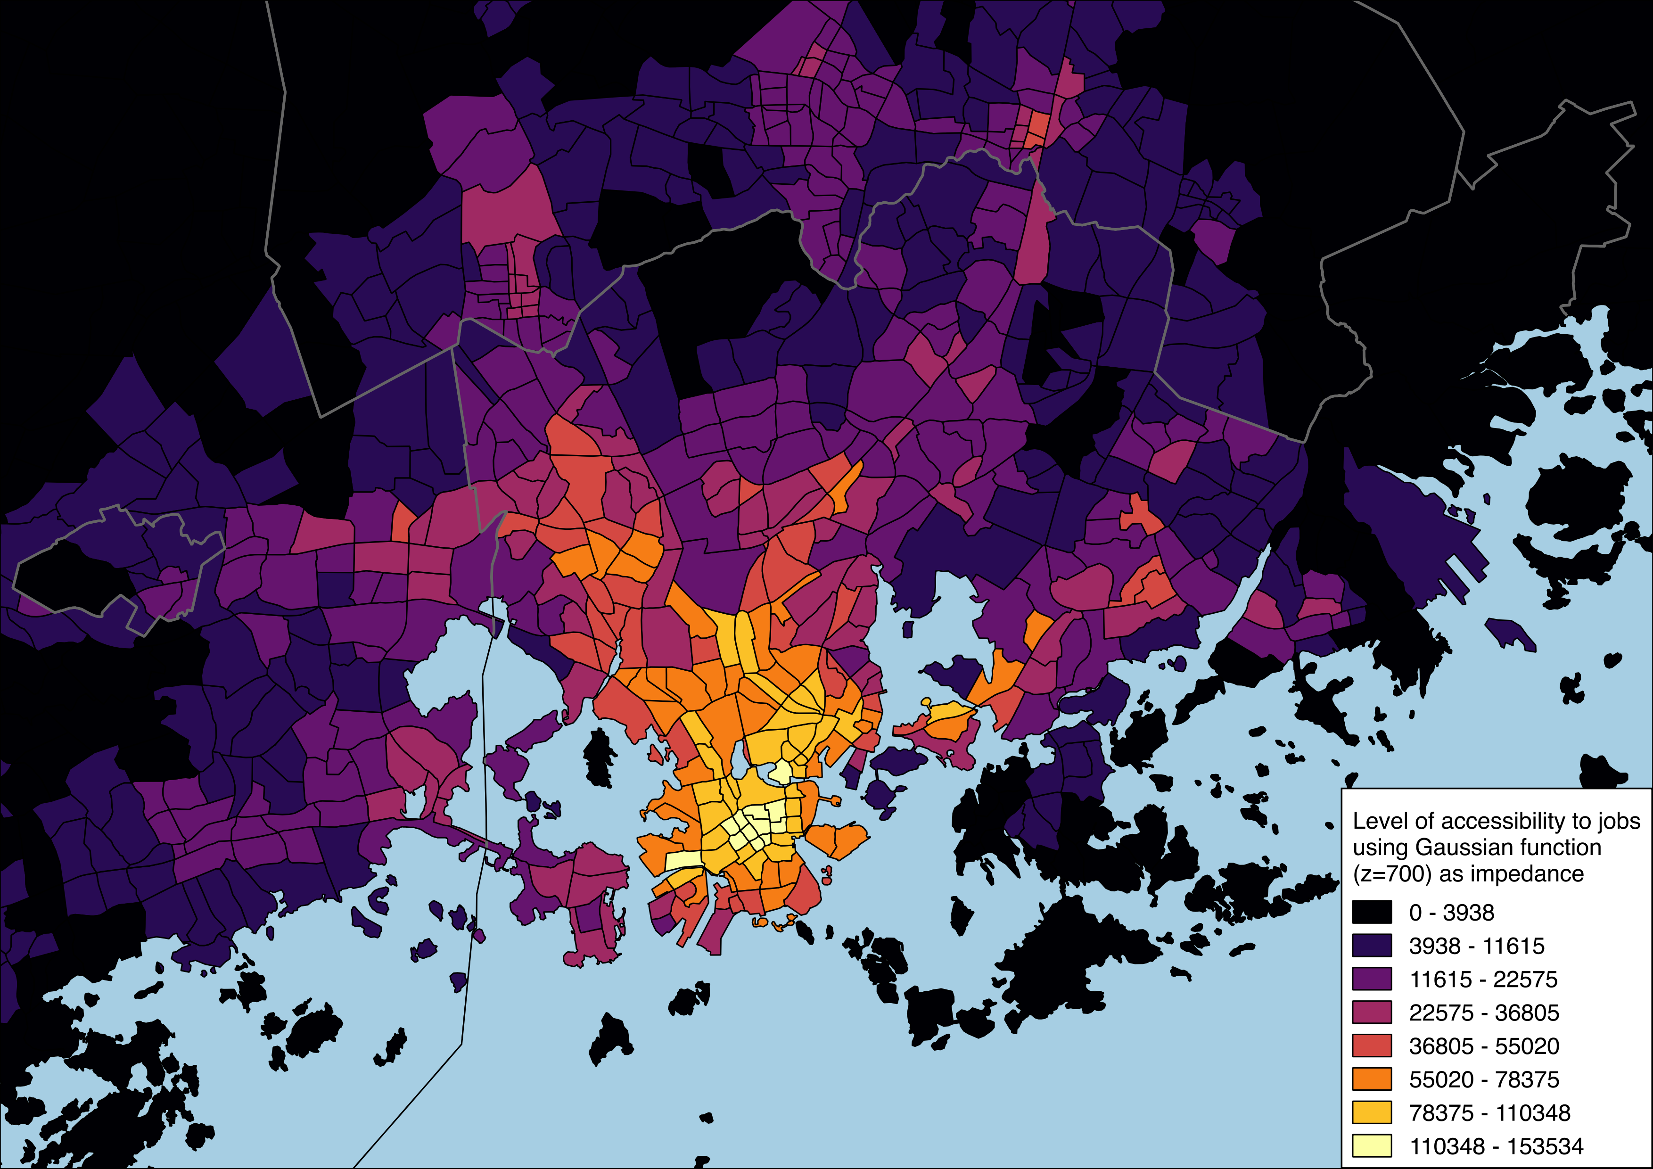
4. Methods (6/8)
Modified Gaussian function
Advantages:
Function is flat-topped in the region of origin
Descent from the ’plateau’ is smooth
Curve reaches zero at infinity

Slide 13
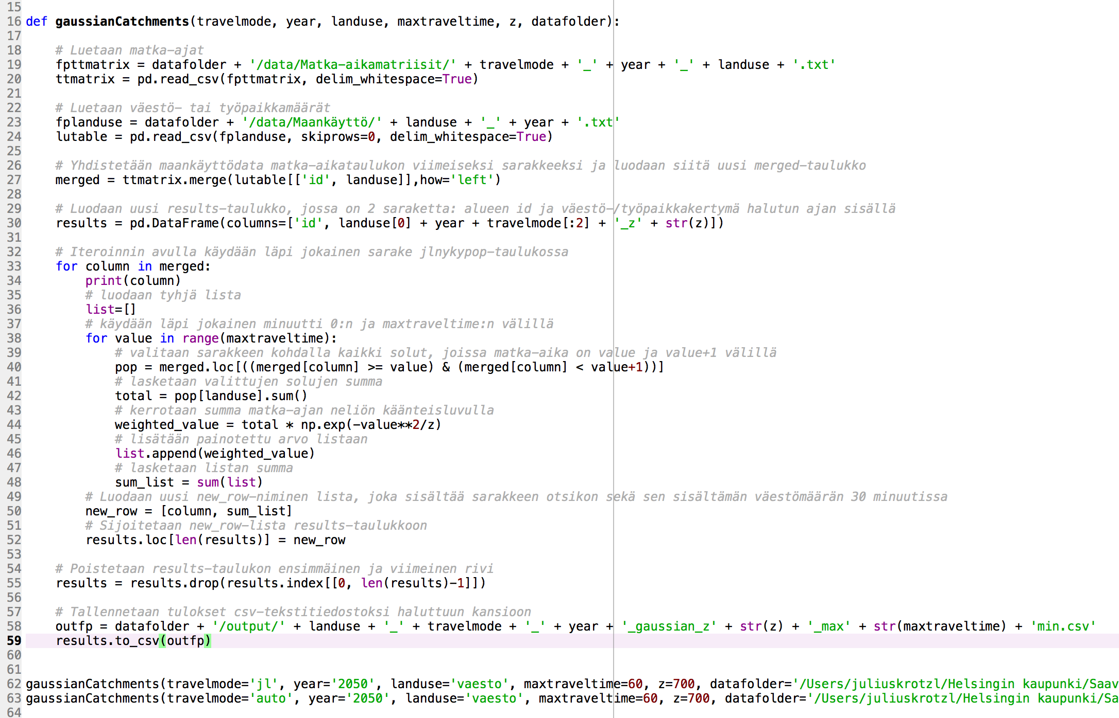
4. Methods (7/8)
Python-function for calculating potential accessibility with user-defined input parameters

Slide 14
4. Methods (8/8)
Which land-use opportunities should be considered when creating accessibility measures of daily mobility patterns?
Purpose of daily trips in Helsinki (Helsingin kaupunki 2017)
Work/school/studying: 35 %
Leisure trip (sports, hobbies, culture etc): 35 %
Shopping trip (groceries etc): 15 %
Running errands (doctor, bank, lunch etc): 8 %
Running errands related to work: 4 %
Trips between different land-use activities, 1000 trips/person/day (HSL 2012)

Slide 15
5. Data sources (1/3)
Travel time data
MetropAccess Travel Time Matrix
Areal division: 250x250 m cells (n=13 231) in Helsinki, Espoo, Vantaa and Kauniainen
Contains travel times for the years 2013, 2015 and 2018
Travel modes: public transportation, car, cycling, walking
HSL HELMET model
Areal division according to pienalue/sectors (n=1918) in the Uusimaa region
Contains travel times of the year 2016 and predictions of travel times in 2030 and 2050, based on the HLJ2015 -transportation system plan
Travel times are calculated using the EMME –traffic simulation program
Travel modes: public transportation, car, cycling
Does not contain time spent for searching a parking lot

Slide 16
5. Data sources (2/3)
Land-use data
SeutuCD 2017: contains different land-use opportunities
HSL HELMET model:
Areal division: pienalue/sectors
Contains predictions of the spatial distribution of population and jobs for 2016, 2030 and 2050
Land-use predictions are based on the MAL2019 -plan
Contains also spatial data of the surface area of shops for 2016

Slide 17
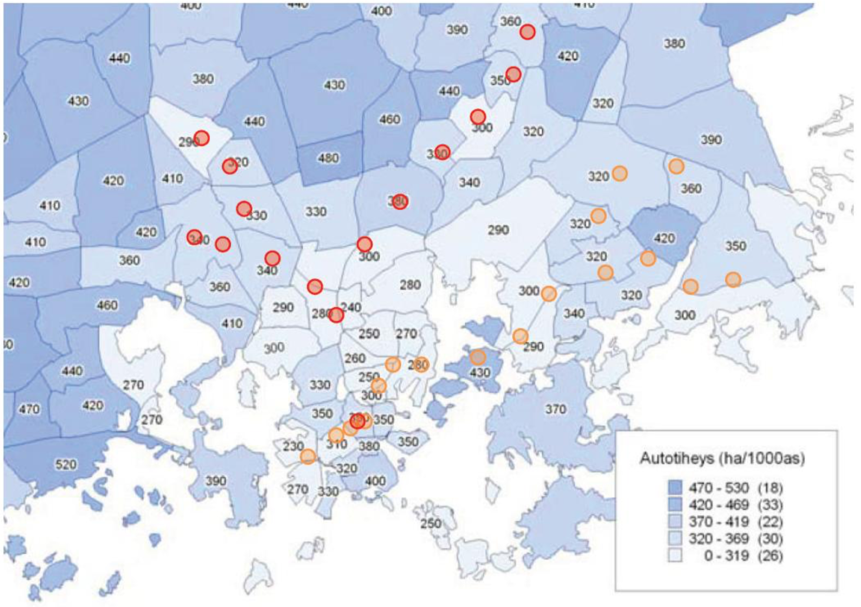
5. Data sources (3/3)
Calibration data
Parking Hub (contains spatial data of the parking spaces and their occupancy rates for each hour)
Limitations:
Does not contain parking data from cars that have a resident parking permit (asukaspysäköintitunnus) or a company parking permit (yrityspysäköintitunnus)
Does not contain data from EasyPark
Does not contain data from the private car parks (EuroPark, Qpark etc)
Spatial data of car ownership and car density per person (Trafi) - ?
Mobility studies
Density of cars per person in Helsinki in 2005/2006 (Palomäki 2011)

Slide 18
6. Expected results
Geographic division of the parking place requirement for new housing areas based on the public transportation system on the whole and cycling accessibility to different activities
Hot spots of the demand for bicycle parking spaces based on cycling accessibility
A comparison between the MetropAccess Travel Time Matrix and the HELMET Travel Time Matrix

Slide 19
7. Schedule of the thesis
October – November:
Collecting scientific literature on parking place planning and defining the accessibility measures to be used
Comparing different accessibility measures
December:
Writing the thesis
January
Writing the results and discussion
February
Finishing the thesis

Slide 20
8. Bibliography
Bertolini, L., le Clercq, F. and Kapoen, L. (2005) ‘Sustainable accessibility: A conceptual framework to integrate transport and land use plan-making. Two test-applications in the Netherlands and a reflection on the way forward’, Transport Policy, 12(3), pp. 207–220. doi: 10.1016/j.tranpol.2005.01.006.
Geurs, K. T. and van Wee, B. (2004) ‘Accessibility evaluation of land-use and transport strategies: Review and research directions’, Journal of Transport Geography, 12(2), pp. 127–140. doi: 10.1016/j.jtrangeo.2003.10.005.
Handy, S. L. and Niemeier, D. A. (1997) ‘Measuring Accessibility: An Exploration of Issues and Alternatives’, Environment and Planning A. SAGE PublicationsSage UK: London, England, 29(7), pp. 1175–1194. doi: 10.1068/a291175.
Helsingin kaupunki (2015) Asuintonttien pysäköintipaikkamäärien laskentaohjeet. Helsingin kaupunki, kaupunkisuunnittelulautakunta.
Helsingin kaupunki (2017) ‘Helsinkiläisten liikkumistottumukset 2017’, Kaupunkiympäristön julkaisuja. Helsingin kaupunki, Kaupunkiympäristön toimiala, (18), p. 55.
Hesse, C. et al. (2012) ‘Erreichbarkeitsmessung: Theoretische Konzepte und empirische Anwendungen’, Diskussionsbeiträge aus dem Institut für Wirtschaft und Verkehr, 3(January).
Hietanen, J. (2014) ‘Helsingin pysäköintipolitiikka’, Helsingin kaupunkisuunnitteluviraston liikennesuunnitteluosaston selvityksiä, 1, p. 83.
Ingram, D. R. (1971) ‘The Concept of Accessibility: A Search for an Operational Form’, Regional Studies. Pergamon Press, 5, pp. 101–107. Available at: http://www.tandfonline.com/doi/pdf/10.1080/09595237100185131 (Accessed: 29 August 2017).
Kalenoja, H. and Häyrynen, J.-P. (2003) Keskustan pysäköinti osana liikennejärjestelmää - Tampereen keskustan pysäköintitutkimus. Available at: http://www.tut.fi/verne/wp-content/uploads/%0Atampereen_keskustan_pysakointitutkimus.pdf.
Kwan, M.-P. (1998) ‘Space-Time and Integral Measures of Individual Accessibility: A Comparative Analysis Using a Point-based Framework’, Geographical Analysis, 30(3), pp. 191–216. doi: 10.1111/j.1538-4632.1998.tb00396.x.
Palomäki, H. (2011) Asukkaiden pysäköintipaikkamäärien optimointi Helsingin esikaupunkialueilla. Aalto-yliopisto, insinööritieteiden korkeakoulu.
Spiekermann, K. and Neubauer, J. (2002) European accessibility and peripherality: Concepts, models and indicators, Nordregio Working Paper. Available at: http://scholar.google.com/scholar?hl=en&btnG=Search&q=intitle:European+Accessibility+and+Peripherality:+Concepts,+Models+and+Indicators#0.
Tobler, W. R. (1970) ‘A Computer Movie Simulating Urban Growth in the Detroit Region’, in Economic Geography, pp. 234–240.
Toivonen, T. et al. (2014) ‘Joukkoliikenteellä, autolla ja kävellen: Avoin saavutettavuusaineisto pääkaupunkiseudulta’, Terra, 126(3), pp. 127–136. Available at: http://www.helsinki.fi/science/accessibility/publications/Toivonen_etal_2014_terra.pdf (Accessed: 18 February 2018).
Vanhapelto, T. (2017) Pysäköintipolitiikan kokonaistaloudelliset vaikutukset. Aalto-yliopisto.

